Slide 1

How to Find your NGO that is trustworthy, and suits your interests and values!

Slide 2
Idea
Find your NGO by
using relevant search criteria
using sorting and filtering functions
examining detailed information and ratings
using its location
taking into account its trustworthiness.

Slide 3
Current State of development

Slide 4
MVP features (planned)
MVP
NGO overview
unfiltered, unsorted
search mask
single search criterion
2
one factor
data sources
trustworthiness
$$scoreRaw\left(NGO\right)=\#dataSourcesListing(NGO)+credibleSource\left(NGO\right)+ECOSOC\left(NGO\right)$$

Slide 5
DEMO

Slide 6
Final Product features (planned)
optional
map view
MVP
registration options for NGOs
Final Product
payment options
unfiltered, unsorted
single search criterion
rating: effectiveness rating
NGO overview
filtering and sorting options
search mask
multiple search criteria
2
one factor
data sources
trustworthiness
multiple factors
>= 3
detail view
comment function & trustworthiness rating

Slide 7
Technology Stack Analysis

Slide 8



Tech Stack then

Slide 9


Tech Stack now
Why the change?
feedback
features don’t need a mobile app
way more data than expected

Slide 10
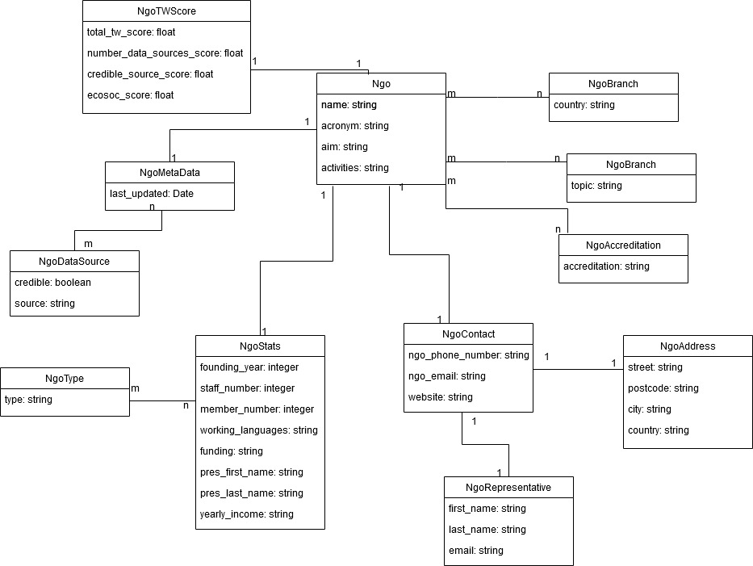
Database focus

Slide 11
Lessons Learned

Slide 12
Problems
Solutions
Defining tasks and who should work on them
Definition of Done unclear → Duplicate Implementations
Weekly Stand Ups: Status Reports and Issue Board
Pull Requests with Reviews

Slide 13
Lessons Learned
Information based products are more suited to be websites
Type checking improves code quality, but linters may lead to unnecessary overformatting, especially if the dev environments aren’t exactly the same

Slide 14



Work Distribution
Frontend | + | ++ | +++
Backend | +++ | ++ | ++
Infrastructure | ++ | +++ | +
Web Scraping | +++ | + | 0
Visual Design | + | 0 | ++

Slide 15
Any questions?

